Slide 1


KRAKEN QGIS PLUGIN • USER MANUAL
Kraken Settings
Technical User Manual
Comprehensive operational reference & technical specification for the Kraken Core Settings Architecture.
CORE MODULE
SUPPORTED DATA LAKES
SettingDialog Engine
DuckDB & PostgreSQL
Kraken © 2026 | akanipatra@gmail.com

Slide 2
ARCHITECTURE OVERVIEW
SettingDialog Structural Flow & Modular Design
Tab 1: Main GCELL
Tab 2: Route Path
Tab 3: KPI Setting
Tab 4: Other / MR Spider
Primary cell layer binding & LTC threshold bounds mapping.
Drive test trajectory mapping & spatial topology toggles.
DuckDB & PostgreSQL analytical engine query builder.
Line of Sight (LOS) profile & Measurement Report vectorization.
Inter-Tab Signal Propagation Architecture
self.tab_gcell.layer_changed_signal.connect( self.tab_kpi.set_main_gcell_fields ) self.tab_gcell.layer_changed_signal.connect( self.tab_other.set_main_gcell_fields )
• Dynamically refreshes Main_GCell Lookups inside Tab 3 (KPI) whenever active GIS layer switches.
• Automatically propagates spatial schema updates to Tab 4 for MR Spider vector calculation.
Kraken © 2026 | akanipatra@gmail.com

Slide 3
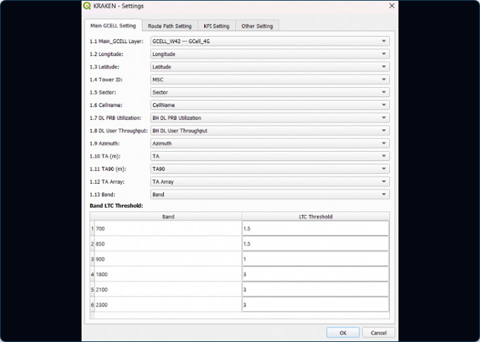
INTERFACE SPECIFICATION
Tab 1 UI: Main GCELL Setting Interface
Field Selection Controls
Allows explicit binding of Sector Layer, Site ID, Sector ID, Latitude, Longitude, Azimuth, and Tilt columns.
LTC Threshold Limits
Configures operational bounds for coordinates, orientation, and mechanical tilt verification during optimization runs.
AUTOMATION FEATURE
Triggers populate_layers_silent() on dialog load to auto-detect matching attribute names.
Kraken © 2026 | akanipatra@gmail.com

Slide 4
TAB 1 CONFIGURATION
Main GCELL Setting & Attribute Binding
Setting Key | Data Type | Target UI Element | Description & Operational Impact
main_gcell_layer_id |  | cmb_main_gcell_layer | Unique QGIS vector layer ID containing sector geometry.
field_cellid / siteid |  | cmb_field_cellid / siteid | Maps GIS attribute fields to primary cell/site spatial identifiers.
field_azimuth / tilt |  | cmb_field_azimuth / tilt | Directs spatial wedge orientation and beam rendering parameters.
ltc_thresholds |  | spn_ltc_* controls | Enforces min/max lat/lon and orientation thresholds for network sanity.
String
String
String
JSON
GCELL Layer Binding
Automated Schema Population
Binds active QGIS vector layers containing cell sector geometry. Establishes primary spatial identifiers for downstream spatial handovers.
Auto-scans attribute tables for standard terms (e.g. azimuth, beamwidth, site_id) to eliminate manual entry errors.
Kraken © 2026 | akanipatra@gmail.com

Slide 5
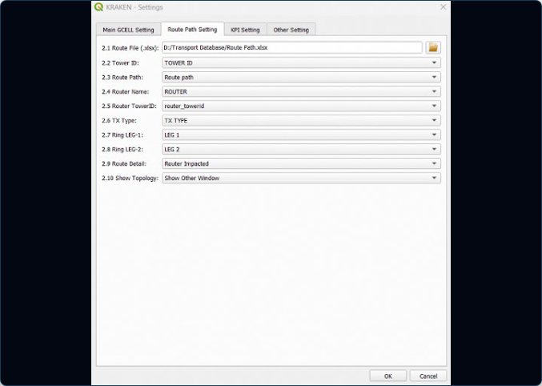
INTERFACE SPECIFICATION
Tab 2 UI: Route Path Setting Interface
Route Path Data File
Supports loading xlsx format of Route Path database.
Measurement Binding
Directly maps database column for topology rendering.
Show Topology Line
Toggleable option to display connecting vector lines from test points to selected site.
Kraken © 2026 | akanipatra@gmail.com

Slide 6
TAB 2 CONFIGURATION
Route Path Parameters
File Path Configuration
Topology Overlay Toggle
Stored under QgsSettings key: Kraken/route_file_path
Stored under QgsSettings key: Kraken/show_topology
Accepts CSV, SHP, or GPKG drive test trajectories. Resolves file locks asynchronously.
Boolean flag toggle to project connection lines between drive test points & serving cell.
Field Mapping Matrix
Detail Decimation Filter
Maps Latitude, Longitude, RSRP, SINR, and Serving Cell ID columns dynamically from source files into memory tables for ultra-fast spatial joins.
Stored under key: Kraken/route_detail
Controls point-decimation sampling density during drive path spatial visual rendering.
Kraken © 2026 | akanipatra@gmail.com

Slide 7
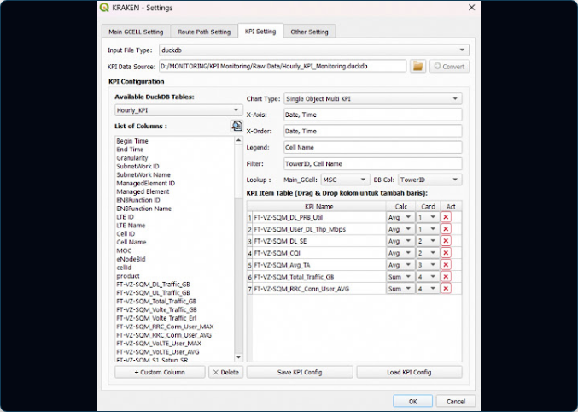
INTERFACE SPECIFICATION
Tab 3 UI: KPI Setting & Data Engine Selector
Engine Radio Options
Allows switching between and modes.
DuckDB (Local File)
PostgreSQL (Server)
Drag-and-Drop Columns
Interactive column list allowing users to drag metrics directly into X-Axis, Legend, or Chart KPI tables.
Custom Column Builder
Pops up dialog to define calculated SQL metrics with custom date/time extractors and math expressions.
Kraken © 2026 | akanipatra@gmail.com

Slide 8
TAB 3 DATA LAKE INTEGRATION
KPI Engine Supported Data Engines
DuckDB Engine
Embedded OLAP
PostgreSQL Engine
Enterprise DB
Key: kpi_file_type = "duckdb"
Key: kpi_file_type = "postgresql"
Ultra-fast vectorized in-process SQL database execution. Ideal for local multi-gigabyte raw KPI data handling.
Centralized database server connection via psycopg2 library. Accesses enterprise network data warehouses.
•
Direct file access via .duckdb or .db path.
Configurable Host, Port, Database, Schema, User & Pass.
•
•
Supports instant Excel & CSV thread conversion.
Inspects information_schema.tables & columns.
•
•
Executes PRAGMA table_info() for dynamic schema discovery.
Supports schema-qualified SQL generation ("schema"."table").
•
Kraken © 2026 | akanipatra@gmail.com

Slide 9
DATA PIPELINE
Threaded File Converter (Excel/CSV to DuckDB)
ExcelToDuckDBThread
CSVToDuckDBThread
Leverages pandas & openpyxl engine to ingest multisheet workbooks into DuckDB tables without UI blocking.
Direct C++ CsvReader copy statement execution for maximum file import speed (gigabytes per second).
Dependency Validator Logic
missing_libs = [] # Checks: duckdb, pandas, openpyxl if missing_libs: Prompt User: "OSGeo4W Shell -> python -m pip install duckdb pandas openpyxl"
If required libraries are missing, Kraken presents an interactive installation guide directing users to the OSGeo4W Shell environment.
Kraken © 2026 | akanipatra@gmail.com

Slide 10
POSTGRESQL CONFIGURATION
PostgresConfigDialog Specification
Field / Setting Key | Default Value | Validation & Behavior
Kraken/pg_host | "localhost" | Hostname or IP address of database server.
Kraken/pg_port | "5432" | Port number (validated numeric string).
Kraken/pg_dbname | Required | Target database name containing KPI schema.
Kraken/pg_schema | "public" | Database schema namespace.
Kraken/pg_user / pg_pass | "postgres" | Stored securely via QgsSettings encrypted registry keyring.
Test Connection Execution Logic
conn = psycopg2.connect( host=host, port=port, dbname=dbname, user=user, password=pass, connect_timeout=5 )
Executes psycopg2.connect() with a strict 5-second timeout to prevent QGIS UI lockups during network latency or firewall drops.
Kraken © 2026 | akanipatra@gmail.com

Slide 11
CUSTOM METRICS
CustomColumnDialog & Formula Generator
Preset Template Engine
Custom SQL Expressions
Auto-detects base time columns containing "begin", "time", or "date".
Allows mathematical evaluation across database columns with zero-division safety:
Template | SQL Expression Generated
Extract Date | "col"::DATE
Extract Time | STRFTIME("col", '%H:%M:%S')
Extract Hour | EXTRACT(HOUR FROM "col")
-- Addition Example: "DL Payload" + "UL Payload" -- Safe Ratio Division Formula: "SSSR Num" / NULLIF("SSSR Denum", 0)
Custom columns are displayed with a distinct fx prefix in column listboxes.
Kraken © 2026 | akanipatra@gmail.com

Slide 12
INTERACTIVE UI
Drag-and-Drop Form Integration Architecture
DraggableListWidget
DropLineEdit
Encapsulates column listbox. Overrides startDrag() to emit plain text MIME data across dialog boundaries:
Accepts text drops for X-Axis, X-Order, Legend, and Filter parameters with custom delimiters:
mimeData = QMimeData() mimeData.setText(col_name) drag.setMimeData(mimeData)
txt_xaxis = DropLineEdit(separator=", ") txt_object = DropLineEdit(separator=" - ")
DropTableWidget Auto-Row Appender
Appends a new KPI Item row automatically upon dragging any column into the KPI table area, assigning default aggregation (Avg) and card index.
Kraken © 2026 | akanipatra@gmail.com

Slide 13
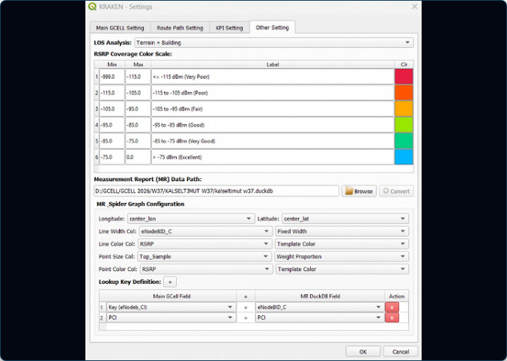
INTERFACE SPECIFICATION
Tab 4 UI: Other Settings & MR Spider Interface
3D Line of Sight (LOS)
Enables DEM terrain elevation profile validation along propagation vectors.
RSRP Ramp Gradient
Configures color stops for signal level mapping on spatial spider lines.
MR Spider Vectorizing
Binds serving & neighbor cell attributes to draw Measurement Report links.
Kraken © 2026 | akanipatra@gmail.com

Slide 14
PORTABILITY
XML Template Import & Export Schema
Exporting XML Configurations
Loading XML & State Safety
Executing save_kpi_config_to_xml() compiles all form controls, custom metrics, and KPI card tables into a portable XML file using minidom.toprettyxml().
Executing load_kpi_config_from_xml() restores configurations while protecting state using the _is_loading guard flag:
duckdb cell_kpi_daily Date...
self._is_loading = True try: tree = ET.parse(file_path) # Populate custom columns & controls finally: self._is_loading = False
Kraken © 2026 | akanipatra@gmail.com

Slide 15
PERSISTENCE REFERENCE
Complete QgsSettings Registry Key Map
QgsSettings Registry Key | Type | Source Tab | Description & Stored State
Kraken/main_gcell_layer_id |  | Tab 1 (GCELL) | Active vector layer ID string.
Kraken/route_file_path |  | Tab 2 (Route) | Drive test point file path (.csv, .shp, .gpkg).
Kraken/kpi_file_type |  | Tab 3 (KPI) | Engine selection ("duckdb" or "postgresql").
Kraken/kpi_items_json |  | Tab 3 (KPI) | Array of KPI item dicts (name, agg, card).
Kraken/kpi_custom_columns_json |  | Tab 3 (KPI) | Dictionary of custom metric SQL expressions.
Kraken/mr_lookup_keys_json |  | Tab 4 (Other) | Measurement report join keys.
String
String
String
JSON
JSON
JSON
Kraken © 2026 | akanipatra@gmail.com

